Slide 1
Networking with Live Interactive Media
Expand the Conversation within Your Networks

Slide 2
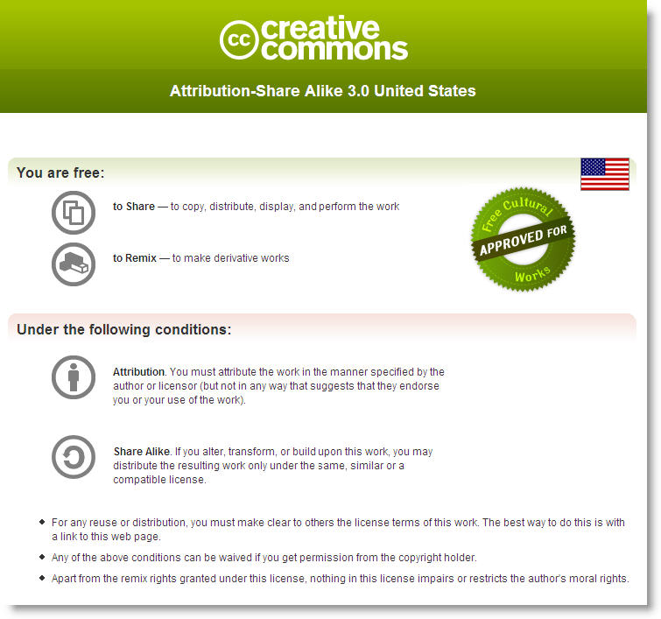

Slide 3
www.EdTechTalk.com/presentations/sln

Slide 4
Can you name the web tool?
1
2
3
4
6
5
7

Slide 5
What does this show?

Slide 6
The power of your network.
Notes:
The power of the network.
Before the presentation …

Slide 7
Meet the EdTechTalk.com Network

Slide 8
The EdTechTalk.com Webcasts
Notes:
Growing network with 11 weekly webcasts
What are webcasts? Live interactive internet “radio” shows.
Focus: Education and Technology

Slide 9
Webcasts are just a part of the story.

Slide 10
Network of Connections
Notes:
The real story is in the informal network of connections formed among participants.

Slide 11
Countless Conversations

Slide 12
Links to Other Networks

Slide 13
Informal Network of Connections

Slide 14
How are connections facilitated?

Slide 15
In the beginning …
Webcast
Text Chat
Audio

Slide 16
Webcast
Text Chat
Social Bookmarks
Micro-blogging
Twitter
Del.icio.us
Diigo
Audio
Live Video
Ustream.tv
Screen Sharing
Yugma
Media Sharing
Flickr
VoiceThread

Slide 18
Our Full List of Tools
http://www.WebcastAcademy.net/tools

Slide 19
Lessons Learned

Slide 20
Why are these connections special?
Informal
Organic
Infinite
Relevant
Redundant
Rapid
Notes:
Informal
Organic
Infinite Reach
Relevant
Redundant - don't get one you need with one node, find another
Rapid
MessyNot always perfect... but when it works .

Slide 21
No guarantees.
Sometimes it works
Connectivity
Participation
Sometimes it doesn’t
Attrition
Confusion
Frustration

Slide 22
No Perfect Tool or Technology.
Don’t get attached
Use what works in your network
Tap into existing tools
Notes:
There are no perfect tools or technologies.
Instead, tap into tools and networks students are using
Find tools that works for your network Don't get attached to your tools

Slide 23
“New” Professional Development
Informal Networks
The New Professional Development
Notes:
This is the "new" on-demand professional development network

Slide 24
Networks for Learning
Student Learning
Network
Notes:
This is the "new" on-demand professional development network

Slide 25
The Networked Classroom
Wiki Syllabus www.eci831.wikispaces.com
Synchronous and Asynchronous Open Conversations
Skype
Ustream.tv
Blogs

Slide 26
Don’t be afraid to fail.
Messy
Magical
Notes:
If you fear the messiness of failure, you won’t experience the magic.

Slide 27
Discussion
How can you expand the conversation within your networks?

